Slide 1

Weather Check- Canada
Team -10,Project-3
Sambulo Malumisa, Sunday Akiyesi, Yalda Alemi And Deepika Mehanti

Slide 2
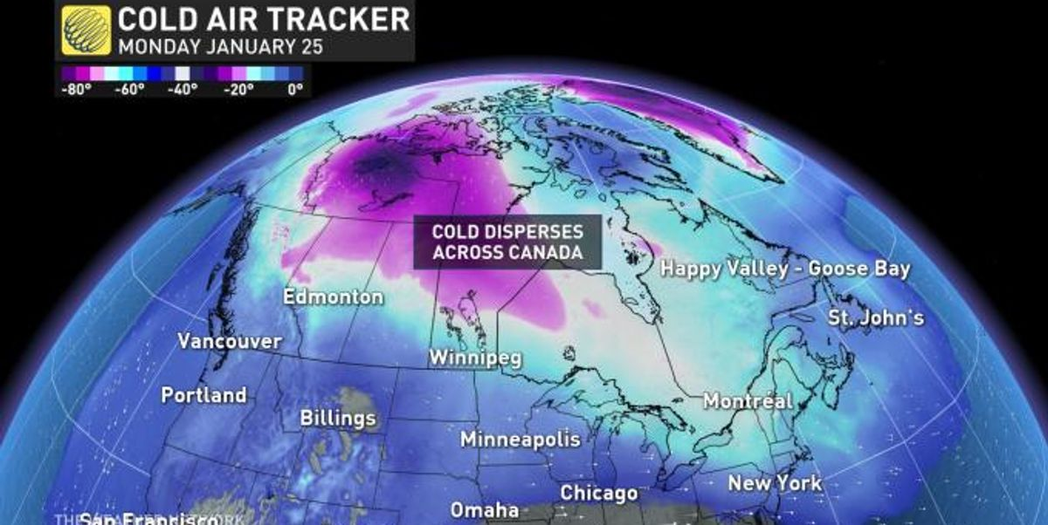
What are we observing with Canada Weather check ? 1. Different cities of Canada with their temperature, pressure, humidity, rainfall Pressure, wind etc. 2. 3 4.

Slide 3
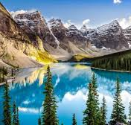
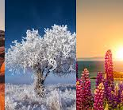
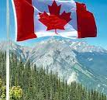
Data Sources
1. https://api.weather.gc.ca/
2. https://worldpopulationreview.com/countries/cities/canada
3. https://api.weather.gc.ca/openapi?f=html3
4. https://www.canada.ca/en/environment-climate-change/services/weather-general-tools-resources/how-we-use-observation-site/understanding-current-conditions-on-website.html
5. https://en.wikipedia.org/wiki/Temperature_in_Canada
6. https://www.kaggle.com/datasets/hemil26/canada-weather

Slide 4
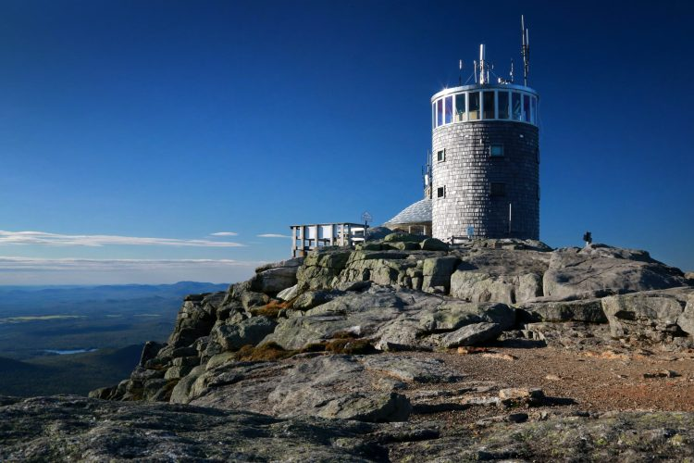
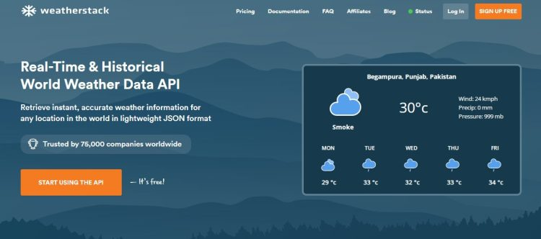
What Is A Weather Data API?
A weather data API is an Application Programming Interface that allows you to integrate real-time weather data and weather forecast data into your apps and websites.
Where Do The Best Weather APIs Get Data From?
The best weather APIs are powered by highly reliable weather data sources, such as large weather stations that cover millions of locations worldwide. This allows these APIs to provide consistent and accurate weather data of almost any location around the world.
A weather station is a station or facility that consists of different instruments for collecting weather observations and data.
Do The Best Weather APIs Provide Highly Accurate And Reliable Data?
The best weather APIs like weather stack source data from some of the largest weather stations and weather data providers around the world. All these data sources are closely monitored for consistency and data accuracy around the clock. This allows the weather stack API to provide accurate and consistent global weather data of millions of cities and towns across the globe.
Weather Parameters
Temperature
Dewpoint
Humidity
Air Pressure
Pressure Tendency
Visibility
Wind
Air Quality
Wind Chill
Humidex

Slide 5
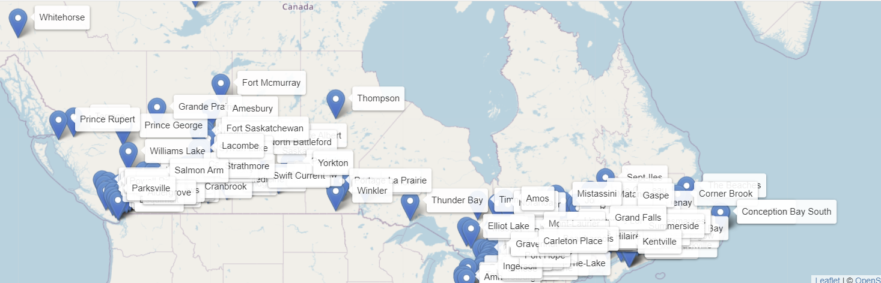
Canada Map showing dropdown menu with : 1. Temperature in Celsius 2. Temperature in Fahrenheit 3. Feels like 4. Humidity 5. Precipitation 6. Pressure 7.Wind
file:///C:/Users/deepi/OneDrive/Desktop/Challange_files/Project_3_team_10/project%203%20me/index.html

Slide 6
ReadMe File
Story behind the Data
Python-Powered Flask
New library (not taught in the class)
Refined the presentation slide
Role Allocation to team members
Plan to meet for 15 minutes (5:10-5:25) before the presentation.

Slide 8
Thank You!
Questions ?

